Slide 1
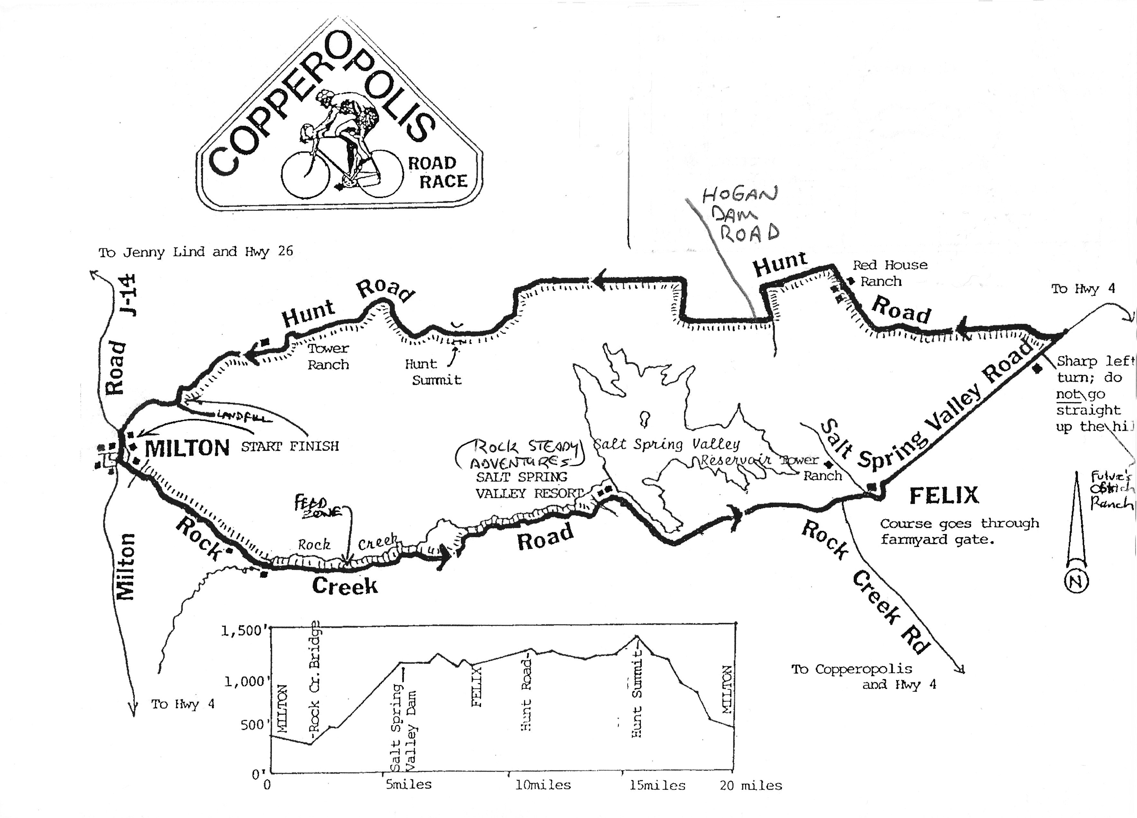
Derrill W7LTM
Remote Base
Coulterville
2023
Hunt Summit is 5.4 miles from NCS
Scott KN6RKY
NCS
Lucian KF6NPG
Wally KK6CPN
John K6JRO
John N6JCS
Patrick KG6AZZ
Ed KF6FIR
Paul W6UHF

